Slide 1
ABIRAMI R
Final Project
3/21/2024 Annual Review

Slide 2
PROJECT TITLE
Face Recognition System
3/21/2024 Annual Review

Slide 3


AGENDA
Problem Statement
Project Overview
Who are the end users?
Solutions and value of propositions
WOW factor in the solution
Modelling
Results
3/21/2024 Annual Review

Slide 4

PROBLEM STATEMENT
Develop a robust face recognition system capable of accurately identifying individuals from images or video frames, even in challenging conditions such as variations in lighting, pose, facial expressions, occlusions, and changes in appearance over time. The system should be efficient, scalable, and capable of handling large datasets while maintaining high accuracy and reliability. The ultimate goal is to deploy the face recognition system in various real-world applications, including access control, surveillance, identity verification, personalized user experiences, and law enforcement, to enhance security, convenience, and efficiency.
3/21/2024 Annual Review

Slide 5

PROJECT OVERVIEW
The aim of face recognition is to develop systems or algorithms that can automatically identify or verify individuals based on their facial features. This technology aims to mimic the human ability to recognize faces, enabling computers to perform tasks such as identifying individuals in images or video frames, verifying identities for access control or authentication purposes, and tracking individuals in surveillance systems.
3/21/2024 Annual Review

Slide 6

WHO ARE THE END USERS?
Face recognition technology serves a diverse range of end users across industries and sectors, offering benefits such as enhanced security, convenience, personalization, and efficiency. Law enforcement agencies use face recognition for criminal identification, surveillance, and monitoring. It helps in identifying suspects, tracking persons of interest, and enhancing public safety. Government agencies utilize face recognition for border control, immigration, passport verification, and national security purposes. It helps in verifying the identity of travelers and preventing fraudulent activities.
3/21/2024 Annual Review

Slide 7

YOUR SOLUTION AND ITS VALUE PROPOSITION
Enhanced Security: Face recognition provides a highly secure method of authentication and access control. Unlike traditional methods such as passwords or PINs, which can be forgotten, stolen, or shared, facial features are unique to each individual, making it difficult for unauthorized users to gain
Accuracy: Advanced face recognition algorithms can achieve high levels of accuracy in identifying individuals, even in challenging conditions such as low lighting, varying poses, or partial occlusions. This accuracy makes face recognition suitable for applications requiring reliable identification, such as law enforcement and
Automation: Face recognition enables automation of various processes, such as attendance tracking, customer identification, and security screening, reducing the need for manual intervention and improving operational efficiency.
Speed: Face recognition technology can process authentication requests quickly, allowing for rapid identification of individuals in real-time.
3/21/2024 Annual Review

Slide 8

THE WOW IN YOUR SOLUTION
The "wow" factor in our solution lies for face recognition includes Implementing a face recognition system that can accurately identify individuals in real-time, even in dynamic environments with varying lighting conditions and camera angles, would be impressive. This could be achieved through efficient algorithms and hardware optimization. Integrating multiple biometric modalities, such as facial features, iris patterns, and voice recognition, to create a more robust and accurate identification system. This fusion of biometric data enhances security and reliability.
Implementing privacy-preserving features such as on-device processing and encrypted storage of biometric data. This ensures that sensitive information remains secure and protected from unauthorized access. Developing a face recognition system that can adapt and improve its accuracy over time by continuously learning from new data and user interactions.
3/21/2024 Annual Review

Slide 9
MODELLING
1. Data Collection: Collecting data for face recognition involves gathering a diverse dataset containing facial images that represent the variability of faces expected to be encountered by the system.
2. Data Preprocessing: Normalize the facial images to ensure uniformity in terms of size, orientation, and intensity.
3. Model Development: Extract relevant features from the preprocessed facial images using the chosen model architecture. For CNN-based models, this typically involves passing the images through multiple convolutional layers to capture hierarchical representations of facial features.
4. Model Training: Train the model on the training dataset using an optimizer such as stochastic gradient descent (SGD), Adam, or RMSprop.
5. Model Evaluation: Calculate evaluation metrics such as accuracy, precision, recall, F1-score, and ROC curves to measure the model's effectiveness in identifying individuals.
6. Prediction on New Data: Enabling accurate identification or verification of individuals from facial images in various real-world applications and scenarios.
7. Tools and Libraries: Utilize Python with TensorFlow and Keras for deep learning, sklearn.metrics for classification performance, NumPy for numerical operations, and Matplotlib for visualization.
3/21/2024 Annual Review

Slide 10
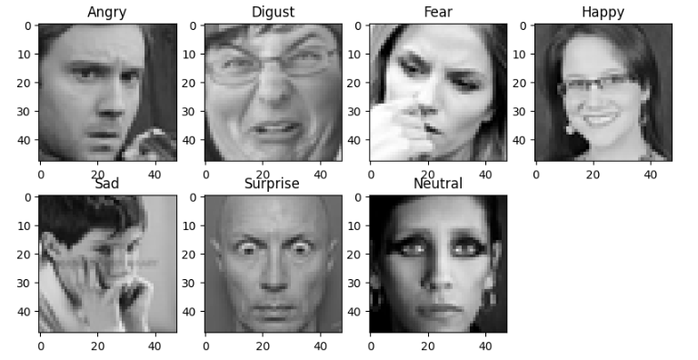
RESULTS
3/21/2024 Annual Review

